Slide 1
Computer Architecture

Slide 2
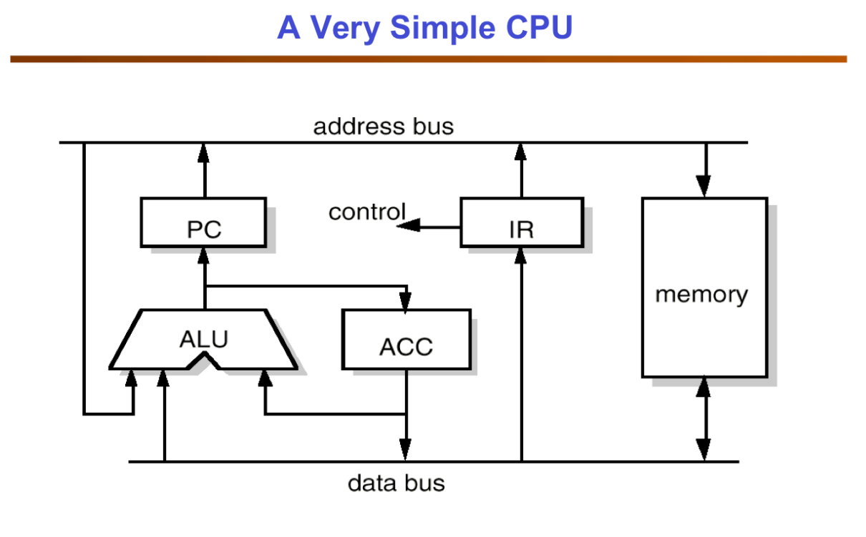
Central Processing Unit
The central processing unit includes registers, an arithmetic logic unit (ALU), and control circuits, which interpret and execute assembly language instructions. The CPU interacts with all the other parts of the computer architecture to make sense of the data and deliver the necessary output.

Slide 3
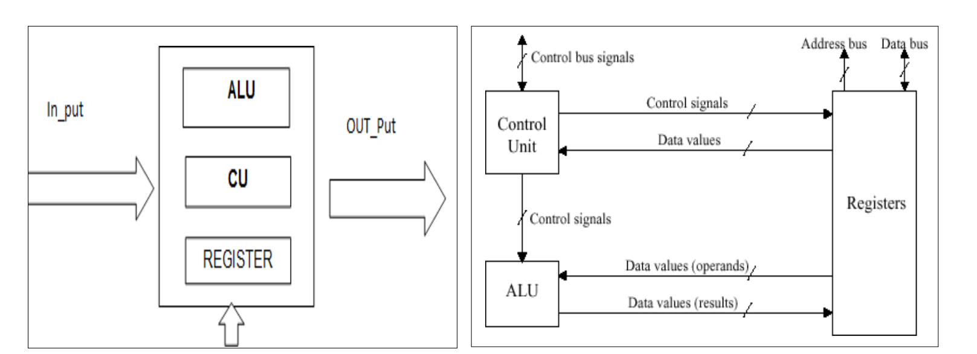
CPU - Registers
These are high-speed and purpose-built temporary memory devices. Rather than being referred to by their address, they are accessed and modified directly by the CPU throughout execution. Essentially, they contain data that the CPU is presently processing. Registers contain information, commands, addresses, and intermediate processing results.

Slide 4
CPU -Registers
The register is used to quickly accept, store, and transfer data and instructions that are being used immediately by the CPU. There are various types of Registers that are used for different purposes. Registers are special-purpose high-speed temporary storage areas for holding data, addresses, and instructions during the processing of the instruction. The register is always on the CPU.
PC: - The program counter (PC) just part of the instruction sequencer in some computers is a processor register. It keeps track of the next memory address of the instruction that is to be executed once the execution of the current instruction is completed. In other words, it holds the address of the memory location of the next instruction when the current instruction is executed.
AC: - The accumulator (AC) is also a type of register used for storing the results that are produced by the System. When the CPU generates some results after processing, then all the results will be stored in the AC Register.
IR: - The Instruction Register stores the instruction currently being executed.

Slide 5
CPU -Registers
MAR: - The Memory address register holds memory addresses of data and instructions. This register is used to access data and instructions from the memory during the execution phase of an instruction. Suppose the CPU wants to store some data in the memory or to read the data from the memory, it places the address of the required memory location in the MAR.
MBR: - The Memory buffer register (MBR) holds the contents of data or instruction read from, or written to the memory. This register is used to store data/instructions coming from the memory or going to the memory.
MDR:-Memory Data Register (MDR) is the register of a computer’s control unit that contains the data to be stored in the computer storage (e.g. RAM), or the data after a fetch from the computer storage. It acts as a buffer and holds anything that is copied from the memory ready for use by the processor.

Slide 6
CPU – Internal Communication (Buses)
There are two types of communication within the CPU.
1. Processor-to-memory communication
2. Processor to I/O device
Communication Bus Architecture:- A bus is a set of wires that is used to connect the different internal components of a computer system for transferring data, address, and control. There may be several buses in a computer system, they are broadly divided into categories.
Serial Bus
Parallel Bus
The speed of any type of bus is measured in terms of the number of bits transferred per second, between two components. In a Serial Bus, only one bit of data is transferred at a time, to the various hardware components. In a Parallel Bus, several bits of data can be transferred at a time, among the various hardware components.

Slide 7
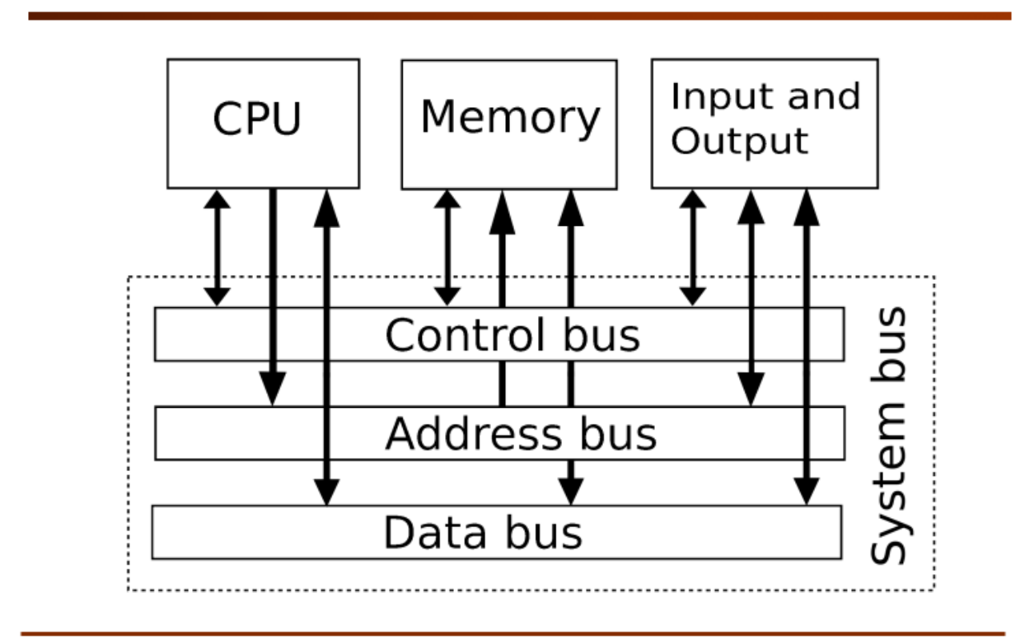
Control Bus
Based on the type of data it carries the Control Bus manages the transfer of data and address among various components by transferring appropriate control signals.

Slide 8
Data Bus
The Data Bus is used to transfer data between the different internal components. The speed of the data bus also affects the overall processing power of a computer system. The modern computer system uses 32-bit data buses for data transfer. This means that these buses can transfer 32 bits of data at a time. The data bus is implemented between the main memory and the processor of a computer system.
A bi-directional data bus allows the transfer of data in both directions. The data bus is generally bi-directional in nature in most computer systems.
The data bus carries the information read from or written to memory. It can be n-bit win width, where n is usually 8, 16, 32, or 64. For example, in a computer that is a 64-bit machine, the internal memory is organised with n=64. Every time a word is fetched from memory, each word is 64-bit. Finally, the control bus provides all the control signals such as the signal to indicate whether you are doing a read or a write operation to memory.

Slide 9
Address Bus
The address bus is also known as the memory bus. It transfers the memory address for reading and writes memory operations. It contains many address lines that determine the range of memory addresses that can be referenced using the address bus. For Example, a 32-bit address bus can be used to reference 2 Memory locations. Like the data bus, the address bus can also be a serial or a parallel bus.
The address bus carries the location information or address of the memory. A K-bit address would allow 2k locations to be accessed and uniquely specified. The address bus is usually driven by the processor chip.

Slide 10
Arithmetic logic unit (ALU)
The arithmetic logic unit includes the electrical circuitry that performs any arithmetic and logical processes on the supplied data. It is used to execute all arithmetic (additions, subtractions, multiplication, division) and logical (<, >, AND, OR, etc.) computations. Registers are used by the ALU to retain the data being processed.

Slide 11
Control unit
The control unit collaborates with the computer’s input and output devices. It instructs the computer to execute stored program instructions via communication with the ALU and registers. The control unit aims to arrange data and instruction processing.
The microprocessor is the primary component of computer hardware that runs the CPU. Large printed circuit boards (PCBs) are utilized in all electronic systems, including desktops, calculators, and Internet of Things (IoT) devices. The Intel 40004 was the first microprocessor with all CPU components on a single chip.
In addition to these four core components, a computer architecture also has supporting elements that make it easier to function.

Slide 12
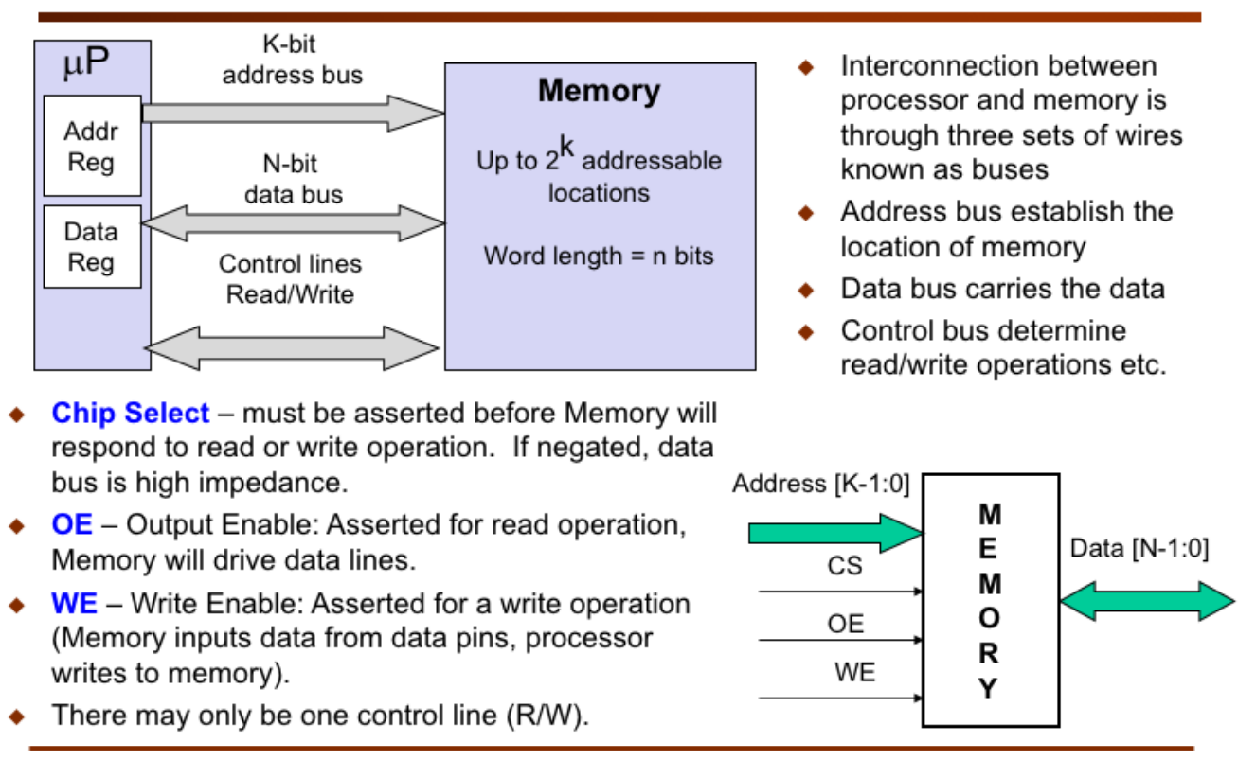
Connecting Processor to Memory

Slide 13
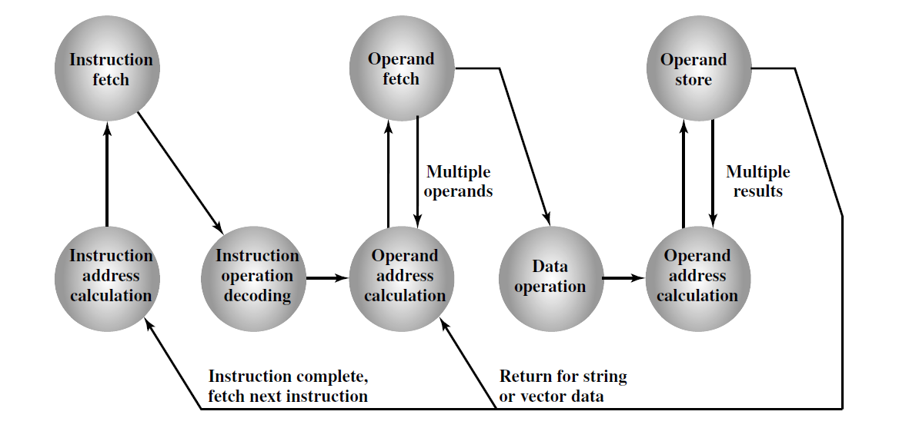
Machine Instruction
The operation of the processor is determined by the instructions it executes, referred to as machine instructions or computer instructions. The collection of different instructions that the processor can execute is referred to as the processor’s instruction set.
Instruction Cycle State Diagram

Slide 14
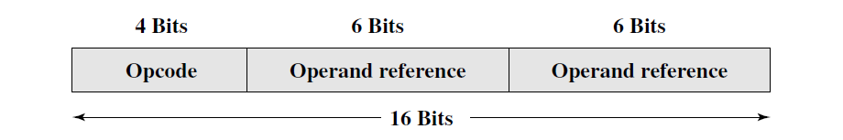
Machine Instruction
Within the computer, each instruction is represented by a sequence of bits. The instruction is divided into fields, corresponding to the constituent elements of the instruction.
With most instruction sets, more than one format is used. During instruction execution, an instruction is read into an instruction register (IR) in the processor. The processor must be able to extract the data from the various instruction fields to perform the required operation. It is difficult to deal with binary representations of machine instructions. Thus, using a symbolic representation of machine instructions has become common.
Opcodes are represented by abbreviations called mnemonics, that indicate the operation.

Slide 15
Elements of a Machine Instruction
Each instruction must contain the information required by the processor for execution. The steps involved in instruction execution and, by implication, define the elements of a machine instruction. These elements are as follows:
Operation code: Specifies the operation to be performed (e.g., ADD, I/O). The operation is specified by a binary code, known as the operation code, or opcode.
Source operand reference: The operation may involve one or more source operands, that is, operands that are inputs for the operation.
Result operand reference: The operation may produce a result.
Next instruction reference: This tells the processor where to fetch the next instruction after the execution of the instruction is complete.
The address of the next instruction to be fetched could be either a real or a virtual address, depending on the architecture.

Slide 16
Instruction Address
The address of the next instruction to be fetched could be either a real address or a virtual address, depending on the architecture. Generally, the distinction is transparent to the instruction set architecture. In most cases, the next instruction to be fetched immediately follows the current instruction. In those cases, there is no explicit reference to the next instruction. When an explicit reference is needed, then the main memory or virtual memory address must be supplied. The form in which that address is supplied will be discussed in memory.
Source and result operands can be in one of four areas:
Main or virtual memory: As with the next instruction references, the main or virtual memory address must be supplied.
Processor register: With rare exceptions, a processor contains one or more registers that may be referenced by machine instructions. If only one register exists reference to it may be implicit. If more than one register exists, then each register is assigned a unique name or number, and the instruction must contain the number of the desired register.
Immediate: The value of the operand is contained in a field in the instruction being executed.
I/O device: The instruction must specify the I/O module and device for the operation.

Slide 17
Instruction Types
Consider a high-level language instruction that could be expressed in a language such as C or Java. For example,
X = X + Y
This statement instructs the computer to add the value stored in Y to the value stored in X and put the result in X. How might this be accomplished with machine instructions? Let us assume that the variables X and Y correspond to locations 513 and 514. If we assume a simple set of machine instructions, this operation could be accomplished with three instructions:
1. Load a register with the contents of memory location 513.
2. Add the contents of memory location 514 to the register.
3. Store the contents of the register in memory location 513.
As can be seen, the single BASIC instruction may require three machine instructions. This is typical of the relationship between a high-level language and a machine language. A high-level language expresses operations in a concise algebraic form, using variables. A machine language expresses operations in a basic form involving the movement of data to or from registers.

Slide 18
Instruction Operations
Instruction operations codes known as Opcodes are represented by abbreviations, called mnemonics, that indicate the operation. Common examples include:
ADD Add
SUB Subtract
MUL Multiply
DIV Divide
LOAD Load data from memory
STOR Store data to memory

Slide 19
Instruction Operations
Operands are also represented symbolically. For example, the instruction may mean add the value contained in data location Y to the contents of register R. In this example, Y refers to the address of a location in memory, and R refers to a particular register. Note that the operation is performed on the contents of a location, not on its address.
ADD R, Y

Slide 20
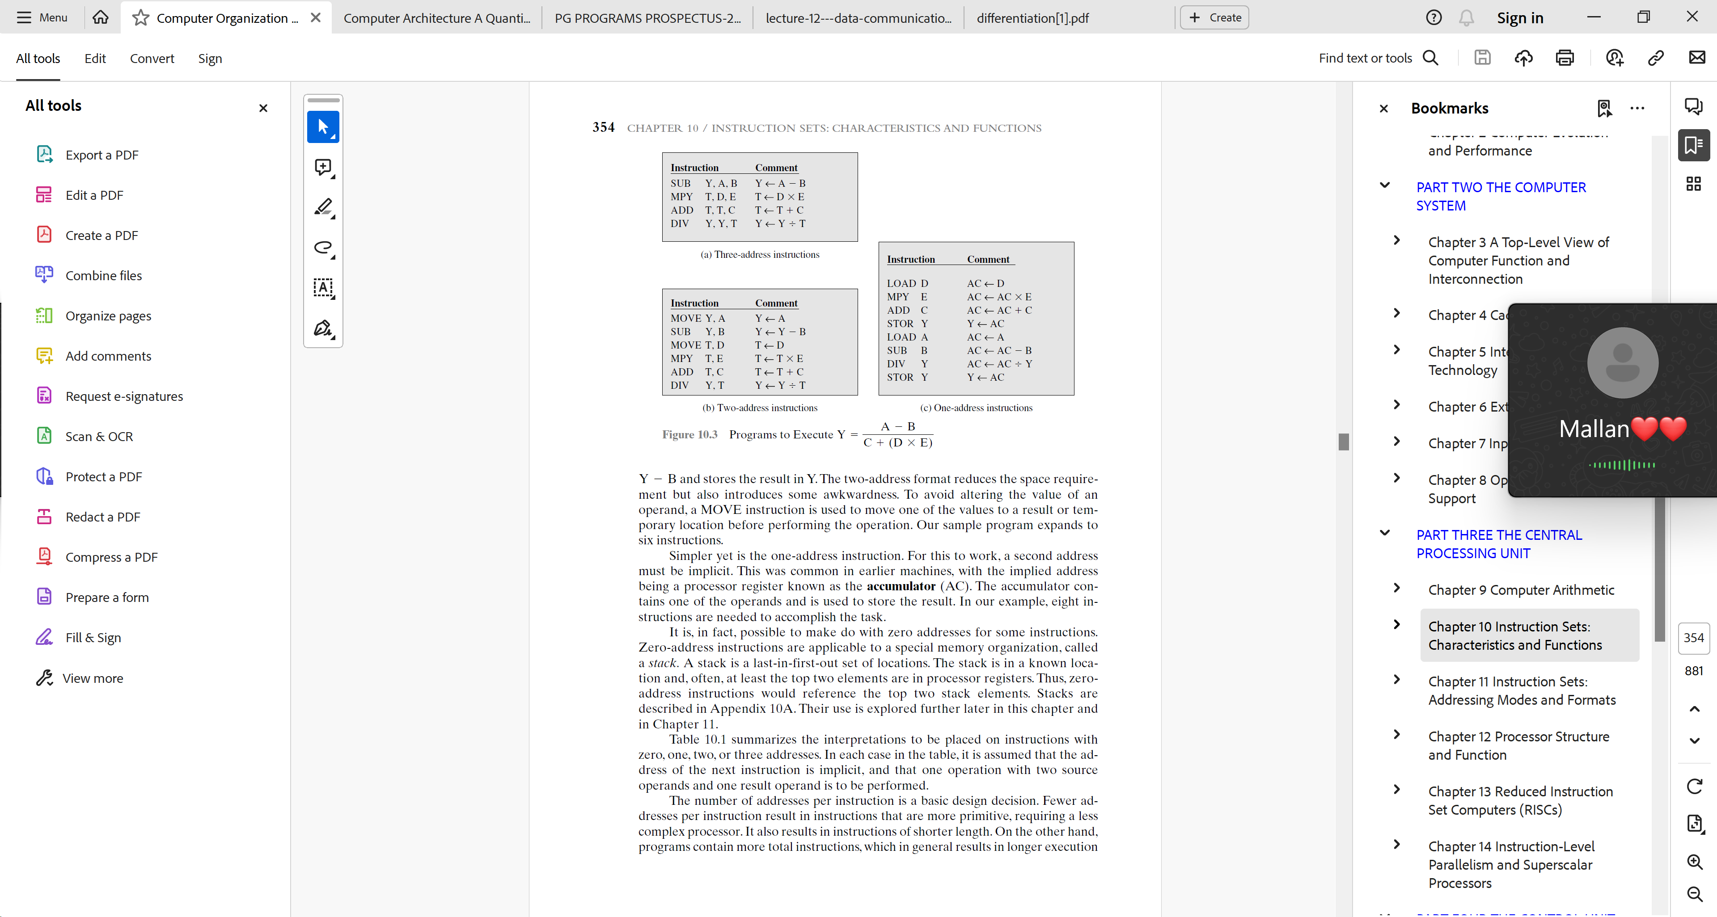
n-Address Instructions

Slide 21
Types of Operands
Machine instructions operate on data. The most important general categories of data are:
- Addresses
- Numbers
- Characters
- Logical data

Slide 22
Numbers
All machine languages include numeric data types. Even in non-numeric data processing, there is a need for numbers to act as counters, field widths, and so forth. There is a limit to the magnitude of numbers represented on a machine. Floating-point numbers must have a precision. It is important to understand the consequences of rounding, overflow, and underflow.
There are three types of numerical data are common in computers:
- Binary integer or binary fixed point
- Binary floating point
- Decimal

Slide 23
Numbers
Although all internal computer operations are binary in nature, the human users of the system deal with decimal numbers. Thus, there is a necessity to convert from decimal to binary on input and from binary to decimal on output. For applications in which there is a great deal of I/O and comparatively little, comparatively simple computation, it is preferable to store and operate on the numbers in decimal form. The most common representation for this purpose is packed decimal. With packed decimal, each decimal digit is represented by a 4-bit code, in the obvious way, with two digits stored per byte.
Thus, this is a rather inefficient code because only 10 of 16 possible 4-bit values are used. To form numbers, 4-bit codes are strung together, usually in multiples of 8 bits. Thus, the code for 246 is 0000 0010 0100 0110. This code is clearly less compact than a straight binary representation, but it avoids the conversion overhead.
Negative numbers can be represented by including a 4-bit sign digit at either the left or right end of a string of packed decimal digits. Standard sign values are 1100 for positive and 1101 for negative. Many machines provide arithmetic instructions for performing operations directly on packed decimal numbers.

Slide 24
Characters
A common form of data is text or character strings. While textual data are most convenient for human beings, they cannot, in character form, be easily stored or transmitted by data processing and communications systems. Such systems are designed for binary data. Thus, some codes have been devised by which characters are represented by a sequence of bits.
Today, the most commonly used character code in the International Reference Alphabet (IRA), referred to in the United States as the American Standard Code for Information Interchange (ASCII). Each character in this code is represented by a unique 7-bit pattern; thus, 128 different characters can be represented. This is a larger number than is necessary to represent printable characters, and some of the patterns represent control characters. Some of these control characters have to do with controlling the printing of characters on a page. Others are concerned with communication procedures.

Slide 25
Characters
IRA-encoded characters are almost always stored and transmitted using 8 bits per character. The eighth bit may be set to 0 or used as a parity bit for error detection. In the latter case, the bit is set such that the total number of binary 1s in each octet is always odd (odd parity) or always even (even parity).
Another code used to encode characters is the Extended Binary Coded Decimal Interchange Code (EBCDIC). EBCDIC is used on IBM mainframes. It is an 8-bit code. As with IRA, EBCDIC is compatible with packed decimal. In the case of EBCDIC, the codes 11110000 through 11111001 represent the digits 0 through 9.

Slide 26
Logical Data
Normally, each word or other addressable unit (byte, half-word, and so on) is treated as a single unit of data. However, it is sometimes useful, to consider an n-bit unit as consisting of n 1-bit items of data, each item having the value 0 or 1. When data are viewed this way, they are considered to be logical data. There are two advantages to the bit-oriented view.
First, we may sometimes wish to store an array of Boolean or binary data items, in which each item can take on only the values 1 (true) and 0 (false). With logical data, memory can be used most efficiently for this storage.
Second, there are occasions when we wish to manipulate the bits of a data item. For example, if floating-point operations are implemented in software, we need to be able to shift significant bits in some operations.
L

Slide 27
Types of Operations
The number of different opcodes varies widely from machine to machine. However, the same general types of operations are found on all machines. A useful and typical categorization is the following:
- Data transfer
- Arithmetic
- Logical
- Conversion
- I/O
- System control
- Transfer of control

Slide 28
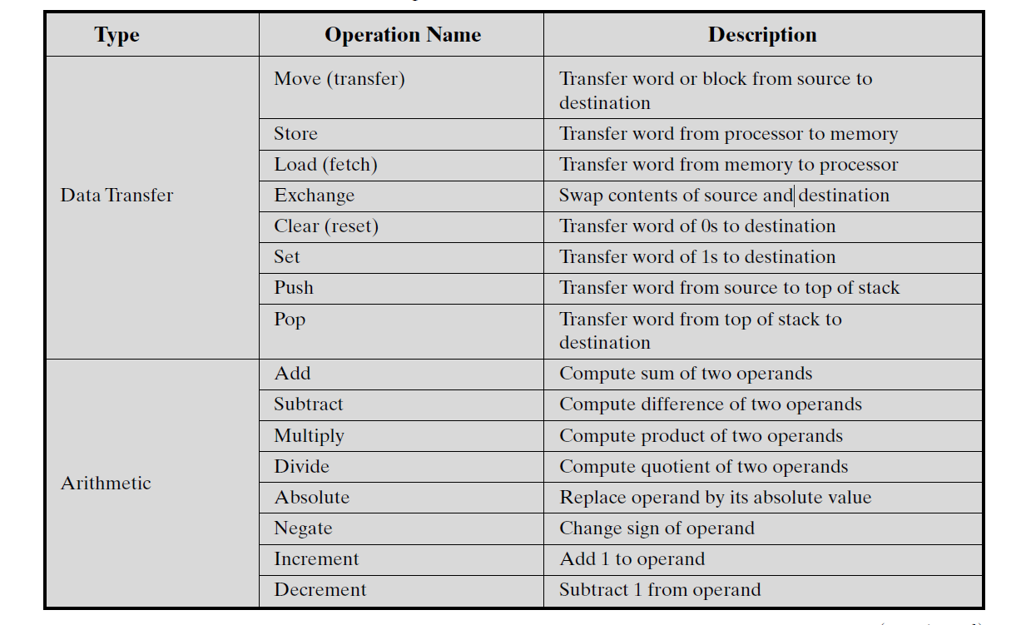
Common Instruction Set Operations

Slide 29
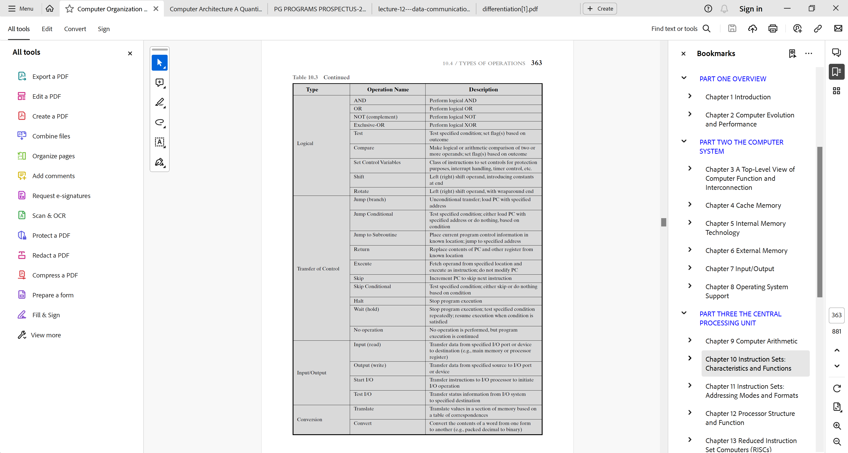
Common Instruction Set Operations

Slide 30
Common Instruction Set Operations

Slide 31
Common Instruction Set Operations

Slide 32
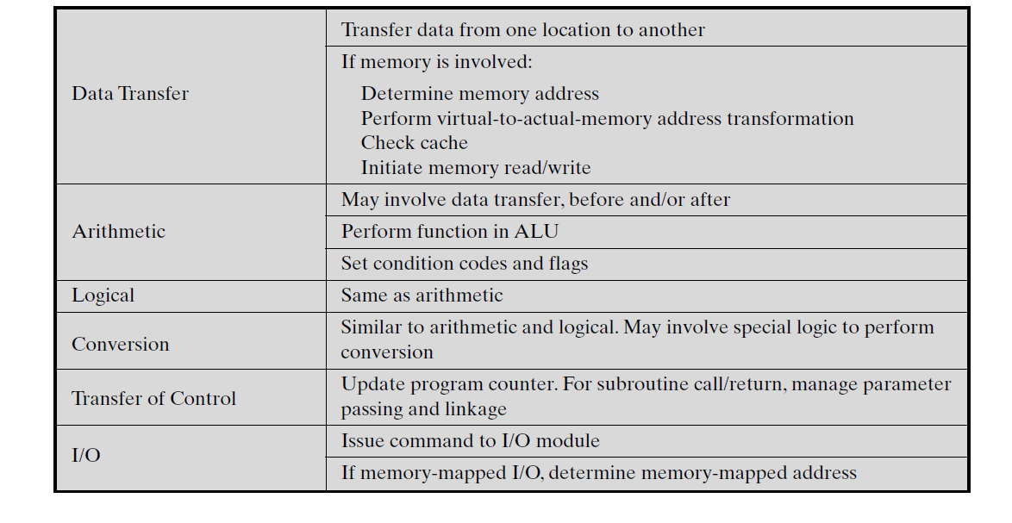
Common Instruction Set Operations

Slide 33
Addressing Modes
The address field or fields in a typical instruction format are relatively small. We would like to be able to reference a large range of locations in main memory or, for some systems, virtual memory. To achieve this objective, a variety of addressing techniques have been employed. They all involve some trade-off between address range and/or addressing flexibility, on the one hand, and the number of memory references in the instruction and/or the complexity of address calculation, on the other.
The most common addressing techniques are:
1. Immediate
2. Direct
3. Indirect
4. Register
5. Register indirect
6. Displacement
7. Stack

Slide 34
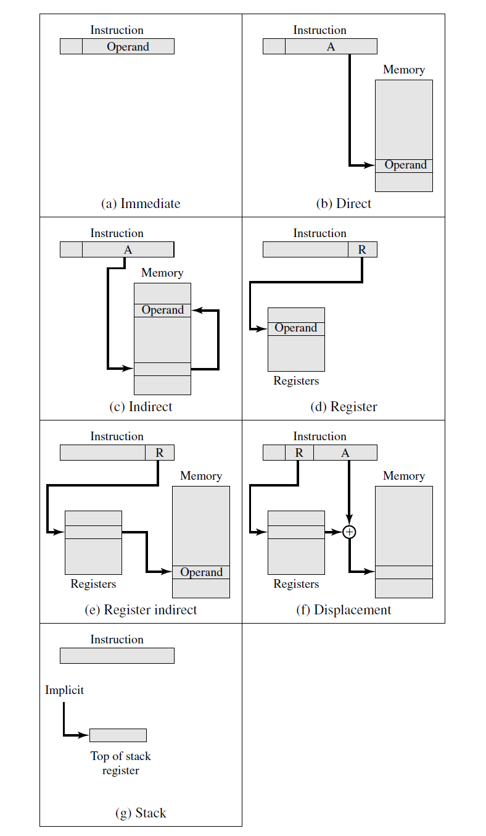
Addressing Modes
The following notations are used for addressing:
A = contents of an address field in the instruction
EA = actual (effective) address of the location containing the referenced operand
R = contents of an address field in the instruction that refers to a register
(X) = contents of memory location X or register X

Slide 35
Immediate Addressing
The simplest form of addressing is immediate addressing, in which the operand value is present in the instruction.
Operand = A
This mode can be used to define and use constants or set initial values of variables. Typically, the number will be stored in twos complement form; the leftmost bit of the operand field is used as a sign bit. When the operand is loaded into a data register, the sign bit is extended to the left to the full data word size. In some cases, the immediate binary value is interpreted as an unsigned nonnegative integer.
The advantage of immediate addressing is that no memory reference other than the instruction fetch is required to obtain the operand, thus saving one memory or cache cycle in the instruction cycle. The disadvantage is that the size of the number is restricted to the size of the address field, which, in most instruction sets, is small compared with the word length.

Slide 36
Direct Addressing
A very simple form of addressing is direct addressing, in which the address field contains the effective address of the operand:
The technique was common in earlier generations of computers but is not common on contemporary architectures. It requires only one memory reference and no special calculation. The obvious limitation is that it provides only a limited address space.

Slide 37
Indirect Addressing
With direct addressing, the length of the address field is usually less than the word length, thus limiting the address range. One solution is to have the address field refer to the address of a word in memory, which in turn contains a full-length address of the operand. This is known as indirect addressing.
EA = (A)
As defined earlier, the parentheses are to be interpreted as meaning “contents of”. The obvious advantage of this approach is that for a word length of N, an address space of 2^{N} is now available. The disadvantage is that instruction execution requires two memory references to fetch the operand; one to get its address and a second to get its value.

Slide 38
Although the number of words that can be addressed is now equal to the number of different effective addresses that may be referenced at any one time is limited to where K is the length of the address field. Typically, this is not a burdensome
restriction, and it can be an asset. In a virtual memory environment, all the
effective address locations can be confined to page 0 of any process. Because the
In

Slide 39
Register Addressing
Register addressing is similar to direct addressing. The only difference is that the address field refers to a register rather than a main memory address:
EA = R
To clarify, if the contents of a register address field in an instruction is 5, then register R5 is the intended address, and the operand value is contained in R5. Typically, an address field that references registers will have from 3 to 5 bits, so that a total of from 8 to 32 general-purpose registers can be referenced.
The advantages of register addressing are that
(1) only a small address field is needed in the instruction
(2) no time-consuming memory references are required.
Since the memory access time for a register internal to the processor is much less than that for a main memory address. The disadvantage of register addressing is that the address space is very limited. If register addressing is heavily used in an instruction set, this implies that the processor registers will be heavily used. Because of the severely limited number of registers (compared with main memory locations), their use in this fashion makes sense only if they are employed efficiently. If every operand is brought into a register from the main memory, operated on once, and then returned to the main memory, then a wasteful intermediate step has been added.

Slide 40
Register Indirect Addressing
Just as register addressing is analogous to direct addressing, register indirect addressing is analogous to indirect addressing. In both cases, the only difference is whether the address field refers to a memory location or a register. Thus, for register indirect address:
EA = (R)
The advantages and limitations of register indirect addressing are basically the same as for indirect addressing. In both cases, the address space limitation (limited range of addresses) of the address field is overcome by having that field refer to a word length location containing an address. In addition, register indirect addressing uses one less memory reference than indirect addressing.

Slide 41
Displacement Addressing
A very powerful mode of addressing combines the capabilities of direct addressing and register indirect addressing. It is known by a variety of names depending on the context of its use, but the basic mechanism is the same. This is referred to as displacement addressing:
EA = A + (R)
Displacement addressing requires that the instruction have two address fields, at least one of which is explicit. The value contained in one address field (value = A) is used directly. The other address field, or an implicit reference based on opcode, refers to a register whose contents are added to A to produce the effective address.

Slide 42
Stack Addressing
The final addressing mode that we consider is stack addressing. A stack is a linear array of locations. It is sometimes referred to as a pushdown list or last-in-first-out queue. The stack is a reserved block of locations.
Items are appended to the top of the stack so that, at any given time, the block is partially filled. Associated with the stack is a pointer whose value is the address of the top of the stack. Alternatively, the top two elements of the stack may be in processor registers, in which case the stack pointer references the third element to the stack. The stack pointer is maintained in a register. Thus, references to stack locations in memory are in fact register indirect addresses.
The stack mode of addressing is a form of implied addressing. The machine instructions need not include a memory reference but implicitly operate on the top of the stack.

Slide 43
CPU Structure and Functions
To understand the organization of the processor, let us consider the requirements placed on the processor.
Fetch instruction: The processor reads an instruction from memory (register, cache, main memory).
Interpret instruction: The instruction is decoded to determine what action is required.
Fetch data: The execution of an instruction may require reading data from memory or an I/O module.
Process data: The execution of an instruction may require performing some arithmetic or logical operation on data.
Write data: The results of an execution may require writing data to memory or an I/O module.

Slide 44
CPU Structure and Functions
To do these things, it should be clear that the processor needs to store some data temporarily. It must remember the location of the last instruction so that it can know where to get the next instruction. It needs to store instructions and data temporarily while an instruction is being executed. In other words, the processor needs a small internal memory.
We can recall that the major components of the processor are an arithmetic and logic unit (ALU) and a control unit (CU). The ALU does the actual computation or processing of data.The control unit controls the movement of data and instructions into and out of the processor and controls the operation of the ALU. In addition, a minimal internal memory, consisting of a set of storage locations, called registers. The data transfer and logic control paths are indicated, including an element labeled internal processor bus. This element is needed to transfer data between the various registers and the ALU because the ALU operates only on data in the internal processor memory.

Slide 45
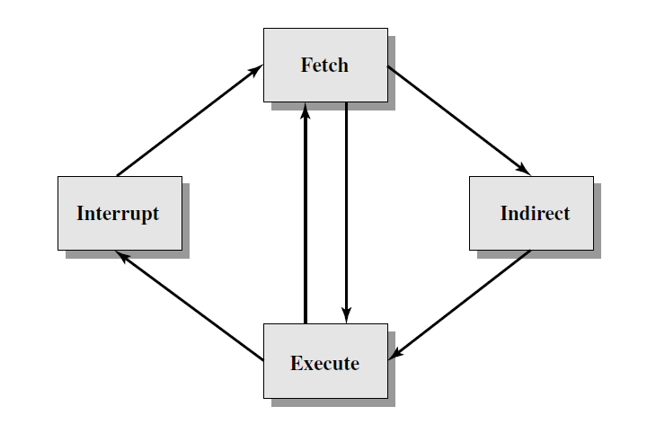
Instruction Cycle
An instruction cycle includes the following stages:
Fetch: Read the next instruction from memory into the processor.
Execute: Interpret the opcode and perform the indicated operation.
Interrupt: If interrupts are enabled and an interrupt has occurred, save the current process state and service the interrupt.

